Slide 1
Introduction to
Neural Networks

Slide 2
Chapter 1
Introduction

Slide 3
Introduction
Why ANN
  Some tasks can be done easily (effortlessly) by humans but are hard by conventional paradigms on Von Neumann machine with algorithmic approach
    Pattern recognition (old friends, hand-written characters)
    Content addressable recall
    Approximate, common sense reasoning (driving, playing piano, baseball player)
  These tasks are often ill-defined, experience based, hard to apply logic

Slide 4
Introduction
Von Neumann machine
--------------------------------------------------------------------------------------------------------------------------------------------------------------------------
One or a few high speed (ns) processors with considerable computing power
One or a few shared high speed buses for communication
Sequential memory access by address
Problem-solving knowledge is separated from the computing component
Hard to be adaptive
Human Brain
--------------------------------------------------------------------------------------------------------------------------------------------------------------------------
Large # (10¹¹) of low speed processors (ms) with limited computing power
Large # (10¹⁵) of low speed connections
Content addressable recall (CAM)
Problem-solving knowledge resides in the connectivity of neurons
Adaptation by changing the connectivity

Slide 5
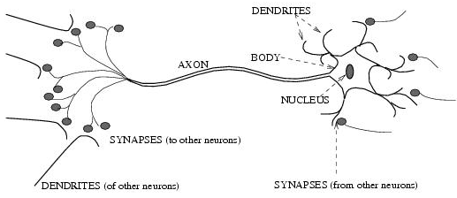
Biological neural activity
  Each neuron has a body, an axon, and many dendrites
    Can be in one of the two states: firing and rest.
    Neuron fires if the total incoming stimulus exceeds the threshold
  Synapse: thin gap between axon of one neuron and dendrite of another.
    Signal exchange
    Synaptic strength/efficiency

Slide 6
Introduction
What is an (artificial) neural network
  A set of nodes (units, neurons, processing elements)
    Each node has input and output
    Each node performs a simple computation by its node function
  Weighted connections between nodes
    Connectivity gives the structure/architecture of the net
    What can be computed by a NN is primarily determined by the connections and their weights
  A very much simplified version of networks of neurons in animal nerve systems

Slide 7
Introduction
ANN
--------------------------------------------------------------------------------------------------------------------------------------------------------------------------
Nodes
  input
  output
  node function
Connections
  connection strength
Bio NN
--------------------------------------------------------------------------------------------------------------------------------------------------------------------------
Cell body
  signal from other neurons
  firing frequency
  firing mechanism
Synapses
  synaptic strength
Highly parallel, simple local computation (at neuron level) achieves global results as emerging property of the interaction (at network level)
Pattern directed (meaning of individual nodes only in the context of a pattern)
Fault-tolerant/graceful degrading
Learning/adaptation plays important role.

Slide 8
History of NN
Pitts & McCulloch (1943)
  First mathematical model of biological neurons
  All Boolean operations can be implemented by these neuron-like nodes (with different threshold and excitatory/inhibitory connections).
  Competitor to Von Neumann model for general purpose computing device
  Origin of automata theory.
Hebb (1949)
  Hebbian rule of learning: increase the connection strength between neurons i and j whenever both i and j are activated.
  Or increase the connection strength between nodes i and j whenever both nodes are simultaneously ON or OFF.

Slide 9
History of NN
Early booming (50’s – early 60’s)
  Rosenblatt (1958)
    Perceptron: network of threshold
    nodes for pattern classification
    Perceptron learning rule
    Percenptron convergence theorem:
    everything that can be represented by a perceptron can be learned
  Widow and Hoff (1960, 19062)
    Learning rule based on gradient descent (with differentiable unit)
  Minsky’s attempt to build a general purpose machine with Pitts/McCullock units
x₁ x₂ x_{n}

Slide 10
History of NN
The setback (mid 60’s – late 70’s)
  Serious problems with perceptron model (Minsky’s book 1969)
    Single layer perceonptrons cannot represent (learn) simple functions such as XOR
    Multi-layer of non-linear units may have greater power but there is no learning rule for such nets
    Scaling problem: connection weights may grow infinitely
  The first two problems overcame by latter effort in 80’s, but the scaling problem persists
  Death of Rosenblatt (1964)
  Striving of Von Neumann machine and AI

Slide 11
History of NN
Renewed enthusiasm and flourish (80’s – present)
  New techniques
    Backpropagation learning for multi-layer feed forward nets (with non-linear, differentiable node functions)
    Thermodynamic models (Hopfield net, Boltzmann machine, etc.)
    Unsupervised learning
  Impressive application (character recognition, speech recognition, text-to-speech transformation, process control, associative memory, etc.)
  Traditional approaches face difficult challenges
  Caution:
    Don’t underestimate difficulties and limitations
    Poses more problems than solutions

Slide 12
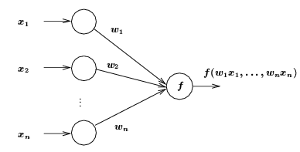
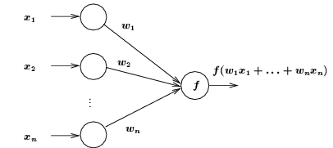
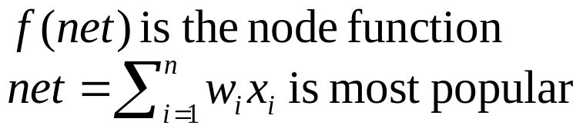
ANN Neuron Models
Each node has one or more inputs from other nodes, and one output to other nodes
Input/output values can be
  Binary {0, 1}
  Bipolar {-1, 1}
  Continuous
All inputs to one node come in at the same time and remain activated until the output is produced
Weights associated with links
General neuron model
Weighted input summation

Slide 13
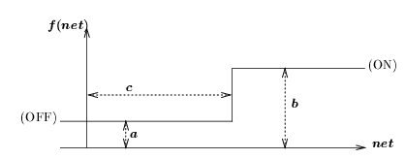



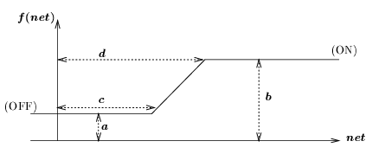
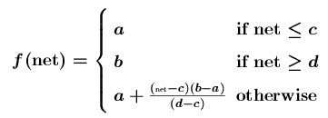
Node Function
Step (threshold) function
where c is called the threshold
Ramp function
Step function
Ramp function

Slide 14
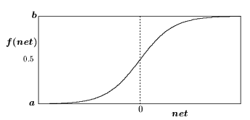



Node Function
Sigmoid function
  S-shaped
  Continuous and everywhere differentiable
  Rotationally symmetric about some point (net = c)
  Asymptotically approach saturation points
  Examples:
Sigmoid function
When y = 0 and z = 0:
a = 0, b = 1, c = 0.
When y = 0 and z = -0.5
a = -0.5, b = 0.5, c = 0.
Larger x gives steeper curve

Slide 15
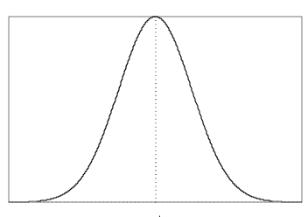

Node Function
Gaussian function
  Bell-shaped (radial basis)
  Continuous
  f(net) asymptotically approaches 0 (or some constant) when |net| is large
  Single maximum (when net = μ)
  Example:
Gaussian function

Slide 16
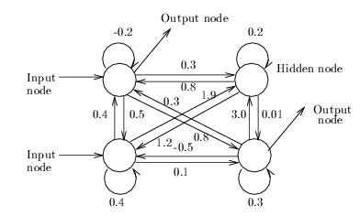
Network Architecture
(Asymmetric) Fully Connected Networks
  Every node is connected to every other node
  Connection may be excitatory (positive), inhibitory (negative), or irrelevant (≈ 0).
  Most general
  Symmetric fully connected nets: weights are symmetric (w_{ij} = w_{ji})
Input nodes: receive input from the environment
Output nodes: send signals to the environment
Hidden nodes: no direct interaction to the environment

Slide 17
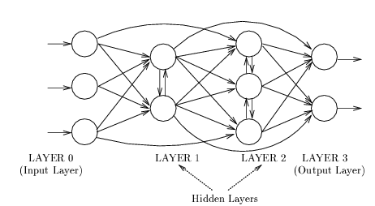
Network Architecture
Layered Networks
  Nodes are partitioned into subsets, called layers.
  No connections that lead from nodes in layer j to those in layer k if j > k.
Inputs from the environment are applied to nodes in layer 0 (input layer).
Nodes in input layer are place holders with no computation occurring (i.e., their node functions are identity function)

Slide 18
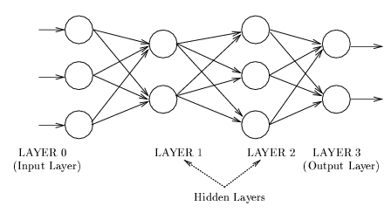
Network Architecture
Feedforward Networks
  A connection is allowed from a node in layer i only to nodes in layer i + 1.
  Most widely used architecture.
Conceptually, nodes at higher levels successively abstract features from preceding layers

Slide 19
Network Architecture
Acyclic Networks
  Connections do not form directed cycles.
  Multi-layered feedforward nets are acyclic
Recurrent Networks
  Nets with directed cycles.
  Much harder to analyze than acyclic nets.
Modular nets
  Consists of several modules, each of which is itself a neural net for a particular sub-problem
  Sparse connections between modules

